Slide 1
Class And Object

Slide 2
Class
A class in OOP is a plan which describes the object. We call it a blueprint of how the object should be represented. Mainly a class would consist of a name, attributes, and operations. Considering the above example, the Mobile can be a class, which has some attributes like Profile Type, IMEI Number, Processor, and some more. It can have operations like Dial, Receive and SendMessage.

Slide 3
Object
Any real world entity which can have some characteristics or which can perform some tasks is called as Object. This object is also called an instance i.e. a copy of entity in programming language. If we consider the above example, a mobile manufacturing company can be an object.

Slide 4
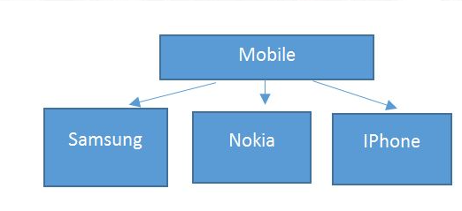
Example :

Slide 5
